Slide 1
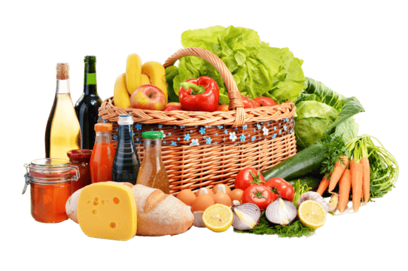
Noel,Linh,Robel
Pantry-Pal

Slide 2
Problems
-People forget what food they already have
-Items run out unexpectedly
-Expiration dates are often hard to track
-Grocery lists are often unorganized

Slide 3
Create
-Users will be able to add to a list of pantry items/groceries. They will first be ordered in terms of expiration (soonest - latest) then, in the order they were added.
-Items will be placed in different categories according to item type
-They will also be asked the quantity of the items added.
-Whilst creating the list users will also be prompted to add when the said item expires.

Slide 4
Retrieve
-After users have added an item they can check to view if it was properly placed into the list.
-They will be able to output the list along with quantity of each item and its expiration date.
-The pantry list will display:
-Item name
-Category
-Quantity
-Expiration date
-Items will be displayed in order of the soonest expiration date for items and the order the items were added (if the expiration dates are the same).

Slide 5
Update
-Expired items are flagged or highlighted for the user and will notify them
-The user will then have the choice of destroying or replacing that said item (essentially just adding another item or deleting it).

Slide 6
Delete
-When the user takes an item off the list, the list will delete that item.
-Items are permanently removed from the local database

